Slide 1
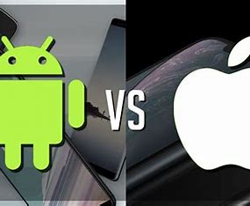
Waze Churn Prevention
A & B Test Results for Android vs iPhone
Completed hypothesis testing for possible links between drive stats on iPhone and Android.
Project is on schedule. Will be incorporating insights from this study into action items going forward.
Currently, iPhone users are taking more drives with Waze per day than Android users.
Recommending targeted special offers to attract Android users into taking more rides per day

